Slide 1

A Global Perspective on Air Pollution
MAY
2024
Data Analysis and Visualization
Final Project Presentation
By
RITIK KUMAR

Slide 2
Contents :-
Introduction
Dataset Overview
Visual 1 - TreeMap Visualization
Visual 2 – FacetGrid View
Visual 3 - Geographical Overview
Table Slide
Visual 4 – United States VS China
Visual 5 – Cluster-wise for the highest air-polluted countries
Visual 6 – Lead Pollutants Affecting the Highly Polluted Countries
Visual 7 – Pollutants Over the Years
Visual 8 – Countries influenced by Carbon dioxide and nitrogen oxide
Conclusion

Slide 3
Introduction
The air we breathe has witnessed a profound transformation, shaped by centuries of industrialization, technological advancements, and societal changes. From the early days of the Industrial Revolution to the present era of heightened environmental awareness, this report employs Tableau visualizations to unravel the complexities of air pollution. Over the years, human activities have released a myriad of pollutants into the atmosphere, affecting the delicate balance of our environment. The interactive visualizations in this report aim to not only showcase the historical trends in air pollution but also provide insights into the global efforts made to mitigate its impact.

Slide 4
Dataset Overview
This dataset delivers an exhaustive examination of various air pollutants discharged globally, covering a broad timeline from 1750 to 2020. The data tracks emissions of key pollutants such as Nitrogen Oxide, Sulphur Dioxide, Carbon Monoxide, Organic Carbon, Ammonia, and Non-methane Volatile Organic Compounds, all quantified in metric tonnes.
Sourced from 'One World Data,' this dataset represents a comprehensive aggregation from various global regions, offering a unique and broad perspective on air pollution. The selection of pollutants and the extensive temporal range provide a thorough insight into both historical and current trends in air quality worldwide.

Slide 5
Visual 1 - Tree Map Visualization of Total Emissions by Top 20 Countries
To gain a clearer understanding of the global distribution of air pollutant emissions, we conducted an analysis focusing on the top 20 countries contributing the most to global emissions, utilizing data from our comprehensive dataset spanning multiple decades with a focus on the year 2019.

Slide 6
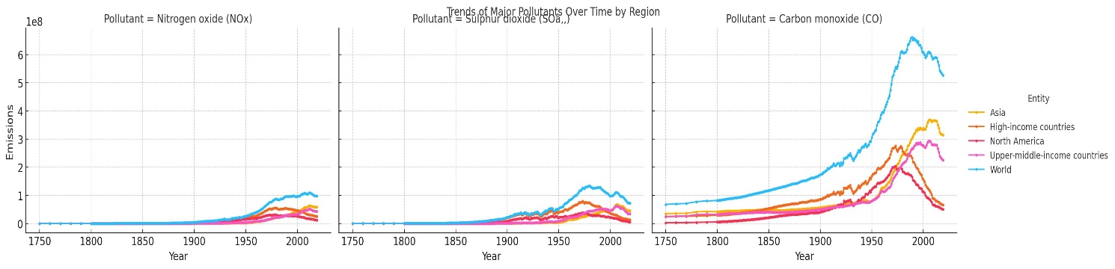
Visual 2 – FacetGrid View
To delve into the dynamic trends of air pollution across different regions, we employed a FacetGrid visualization approach using Python's Seaborn library, focusing on data spanning multiple decades. The dataset, loaded from an Excel file, includes comprehensive emissions data for pollutants such as Nitrogen oxide, Sulphur dioxide, Carbon monoxide, Organic carbon, NMVOCs, Black carbon, and Ammonia.

Slide 7
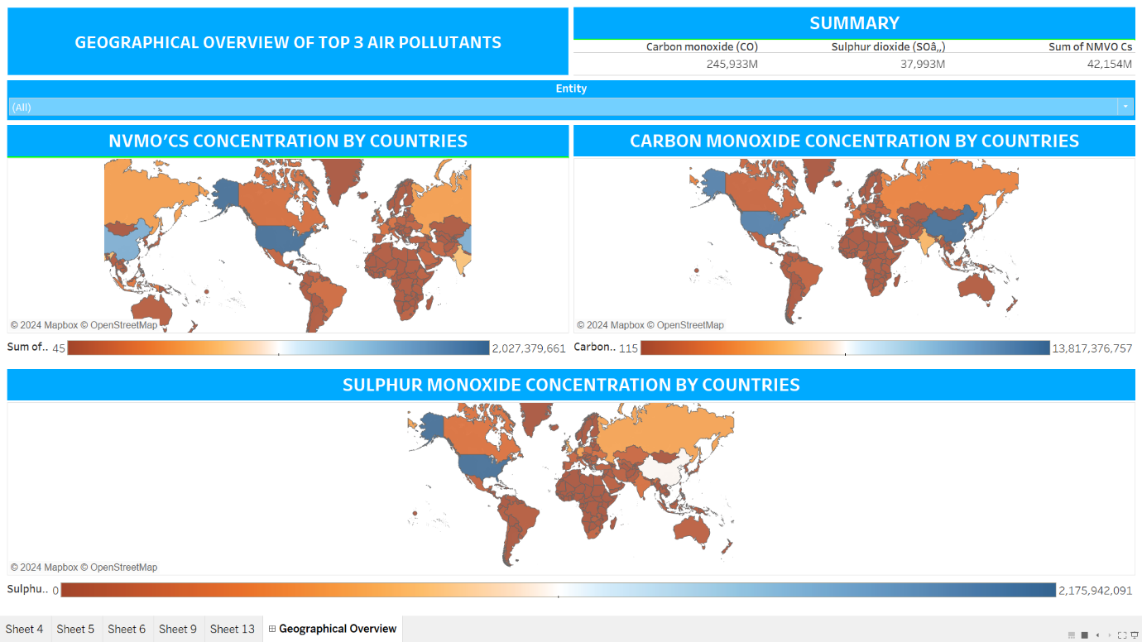
Visual 3 - Geographical Overview

Slide 8
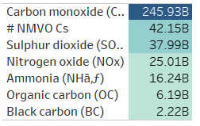
TABLE SLIDE
Our initial visualization showcases the impact of the three primary pollutants contributing to global air pollution. This visual provides a geographic representation of how these pollutants are distributed across different countries. It utilizes varying shades of color to indicate the intensity of pollutant concentrations, offering a clear depiction of regional pollution levels. Additionally, the graph displays the concentrations of each pollutant in parts per million, allowing for a detailed analysis of specific pollutants.

Slide 9
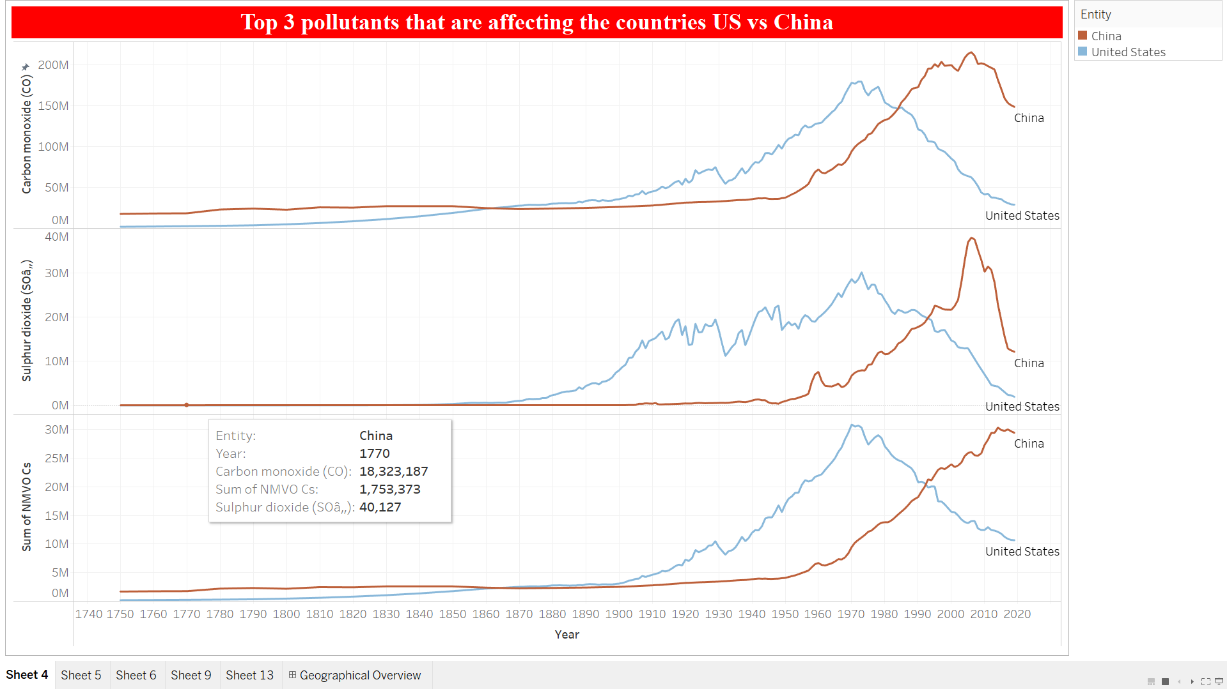
Visual 4 – United States VS China
In our initial visualization, we identified the United States and China as the two countries most significantly impacted by the top three air pollutants. This line graph delves into how these pollutants have individually influenced each country over the years. A particular focus is given to Non-methane Volatile Organic Compounds (NMVOCs). We observe that while NMVOC levels have been rising in China, they have notably decreased in the United States.

Slide 10
Visual 5 – Cluster wise for the highest air-polluted countries
The visualization focuses on analyzing air pollution trends across different nations over time, highlighting the United States, China, India, Germany, and the United Kingdom as the five countries most affected by air pollution. This finding can be attributed to a combination of factors including population density, levels of industrialization, economic development, energy consumption, and emissions from transportation.

Slide 11
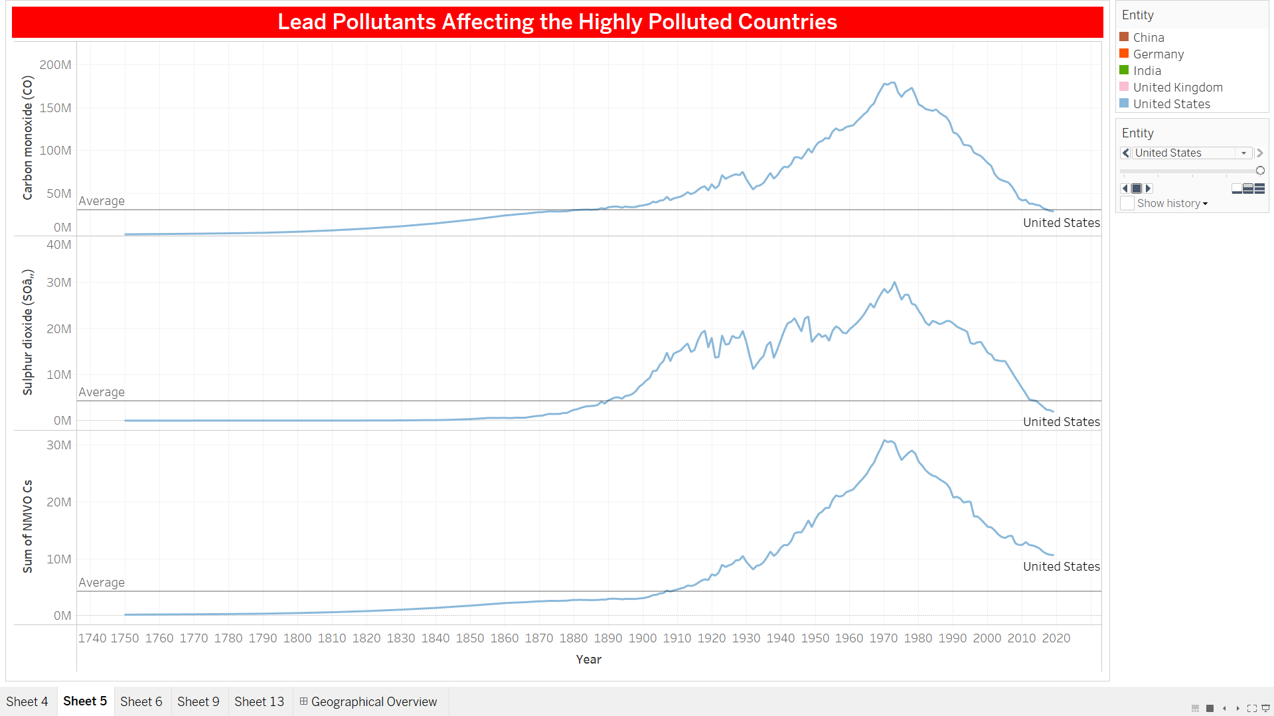
Visual 6 – Lead Pollutants Affecting the Highly Polluted Countries

Slide 12
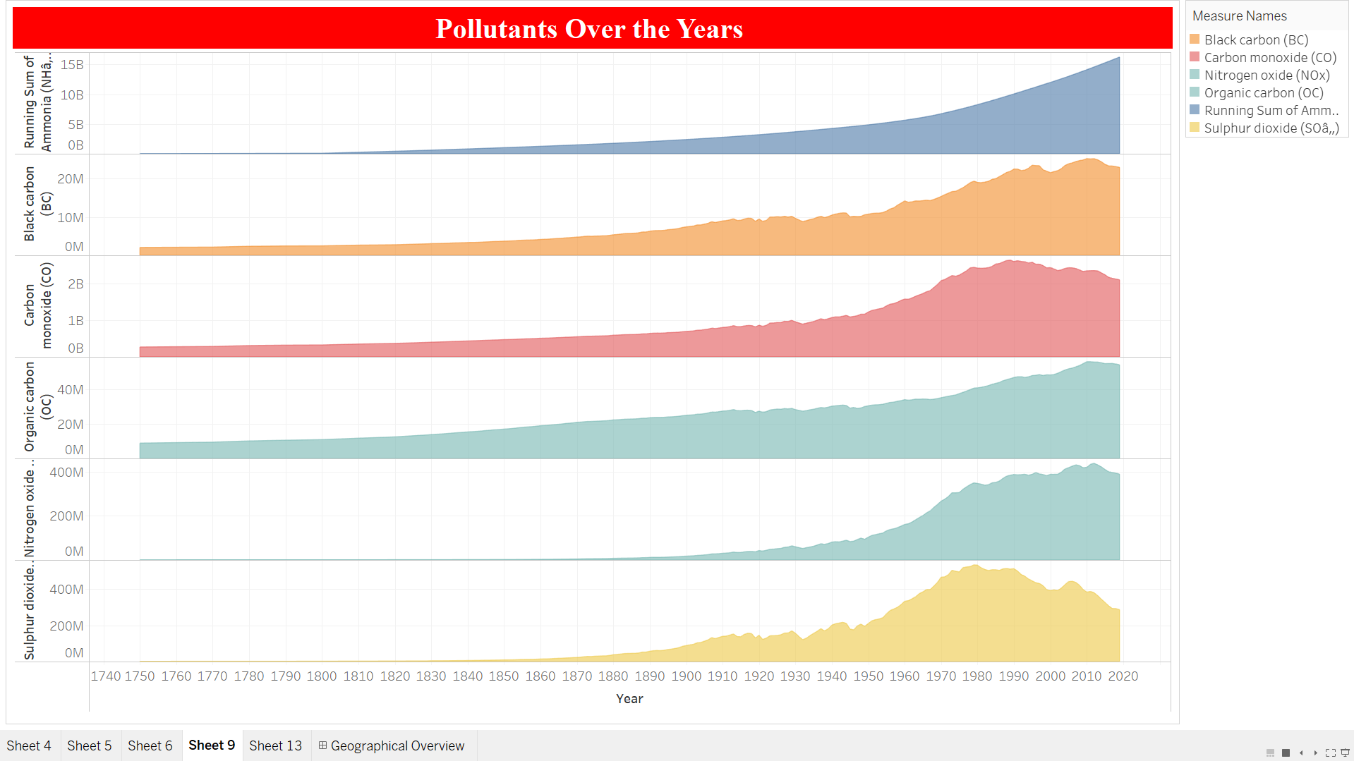
Visual 7 – Pollutants Over the Years
This visualization examines the contribution of various air pollutants to overall air pollution from the 1800s through 2020. The data highlights a significant escalation in air pollution beginning around 1900, coinciding with the era of intense industrialization and urbanization. This historical analysis provides a clear linkage between human activities and the rise in air pollution, underscoring the impact of industrial processes, transportation, and other human-driven factors on air quality. The graph details the roles of ammonia, sulfur dioxide, organic carbon, carbon monoxide, NMVOCs, and nitrogen oxide, illustrating the intricate relationships among these pollutants. Each pollutant originates from different sources and contributes uniquely to air quality issues. This detailed visualization serves as an essential tool for tracing the evolution of air pollution over centuries and highlights the urgent need for sustainable practices and policy measures to combat the environmental challenges posed by these emissions.

Slide 13
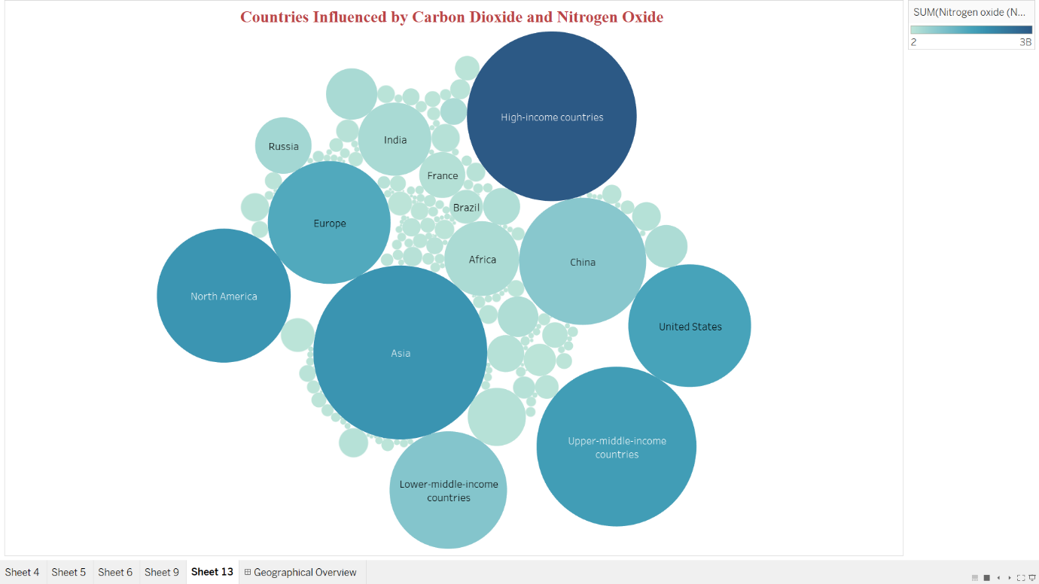
Visual 8 – Countries influenced by Carbon dioxide and nitrogen oxide
The visualization, titled "Countries Influenced by Carbon Dioxide and Nitrogen Oxide," utilizes a bubble chart to depict the relative impact of these two key air pollutants across various global regions. In this chart, the size of each bubble represents the combined emissions of Carbon Dioxide (CO2) and Nitrogen Oxide (NOx) for the corresponding region, offering a clear visual representation of the distribution and severity of pollution contributed by each area. Notably, the chart highlights that high-income countries, along with China and the United States, show significantly larger bubbles, indicating their major contributions to global emissions.

Slide 14

Conclusion
In conclusion, the extensive data analysis and visualizations provided in this study demonstrate the complex nature of air pollution, influenced by a range of economic, regulatory, technological, and societal factors. While the United States and China are significant contributors to global pollution levels, their differing trends highlight the effects of various approaches, including stringent regulatory frameworks and the implementation of cleaner technologies. The primary pollutants impacting these nations, such as NMVOCs, CO, and SO2, show varied trends that are shaped by levels of industrialization, regulatory measures, and public consciousness. Additionally, the analysis pinpoints crucial pollutants in Germany, India, and the United Kingdom, underscoring the necessity for customized approaches to address these issues. Overall, the findings emphasize the critical need for global initiatives focused on sustainable practices and policy actions to reduce air pollution effectively.

Slide 15
THANK YOU!
Ritik Kumar
Email
rk1208@rutgers.edu

